Slide 1
How to Setup & Run this Project
Install NodeJs ( Ignore If Already Installed)
Visit the official Node.js website i.e) https://nodejs.org/en/download/
Download the latest version Node.js installer
Run the installer.
Follow the prompts in the installer.

Slide 2
—First Run Backend then Frontend & Admin—
Steps To Setup Backend Of The Project
Open Project Folder(Vertex Hospital) In VS Code
Open Integrated Terminal
- Right Click on ‘backend’ > Select “Open In Integrated Terminal”
Type “npm install” and press Enter and Wait for Installation to be completed (requires Internet)

Slide 3
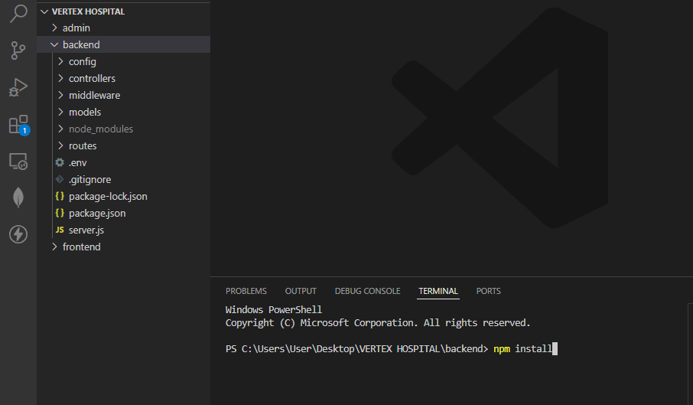

Slide 4
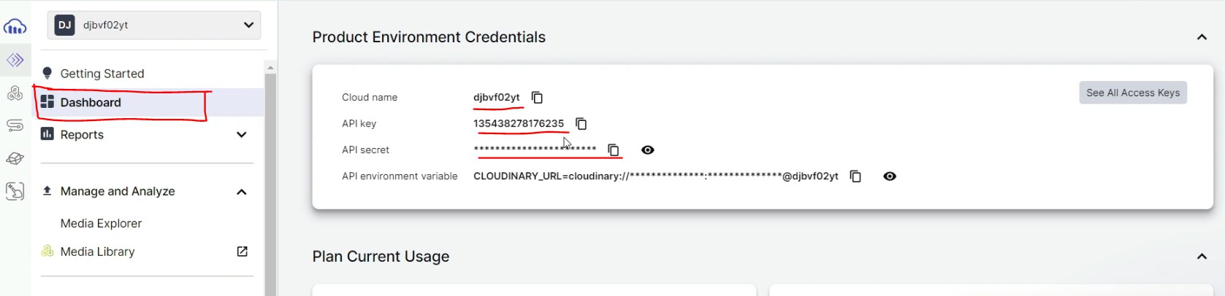
Setup Cloudinary for file storage.
Create account ( use of email id and password of your choice) and login to:
https://cloudinary.com/ Then go to Dashboard

Slide 5
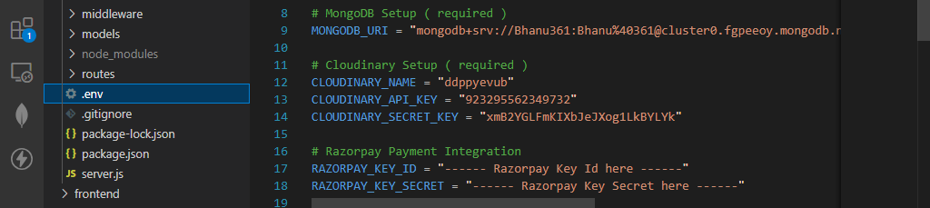
Copy and paste the Cloud Name, API Key, And Secret Key in the
backend → .env file:

Slide 6
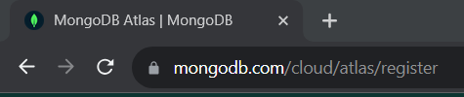
Setup The MongoDB
Open the below mentioned link in chrome.
After that Sign Up with Google on the website and see what
Atlas is capable for free .

Slide 7
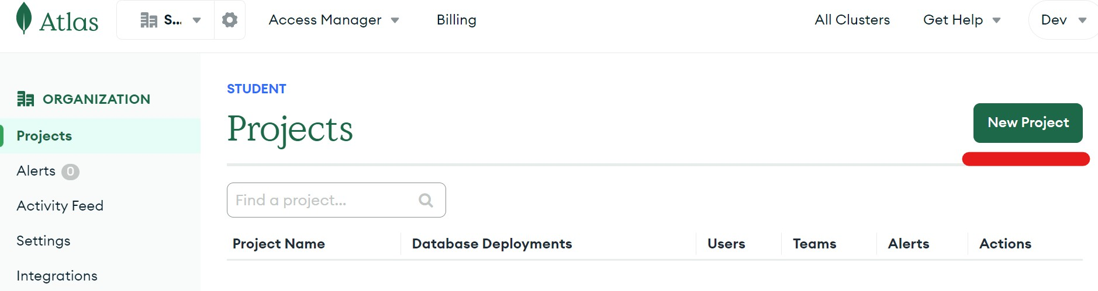
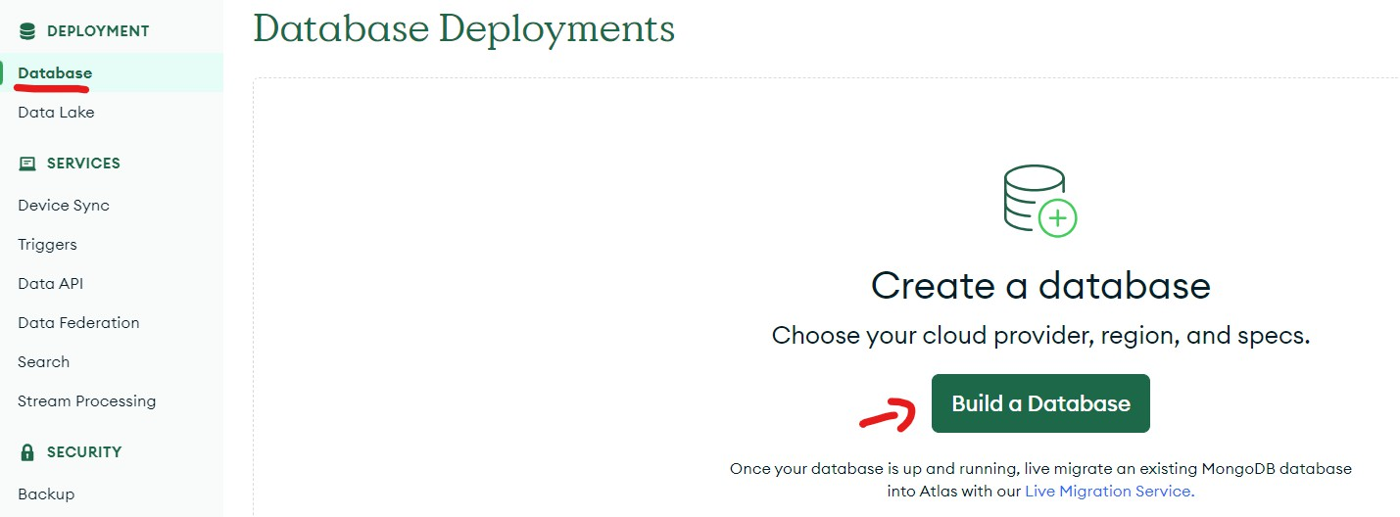
On Atlas dashboard click on New Project Option
After Creating Project go to Database Section & Build a database

Slide 8
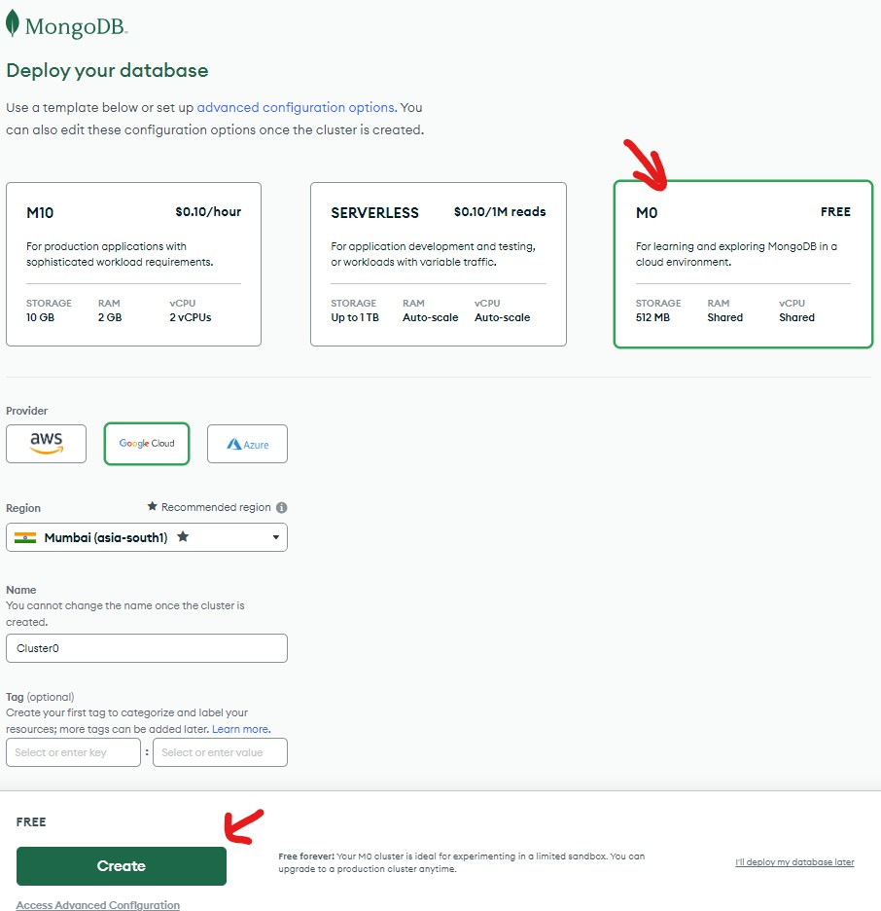
Select M0 & Your Region & Create Database

Slide 9
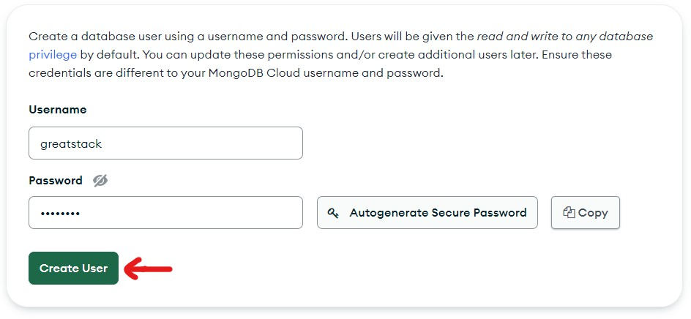
Setup Username & Password & Create User
vertex hospital
Note: Do not use ‘@’ symbol in the password otherwise it will show error and if mistakenly you select ‘@’ then put %40 instead of @ symbol.

Slide 10

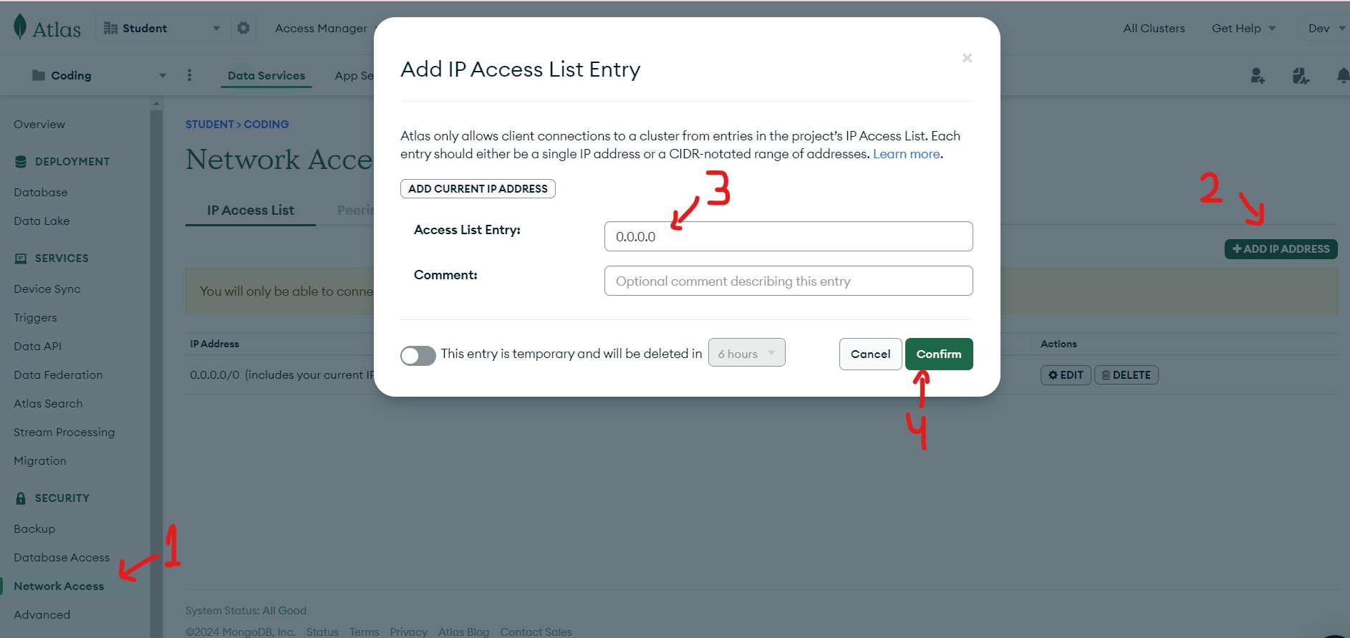
Now Click on Finish & Close
Whitelist IP 0.0.0.0 & Click on Add Entry

Slide 11
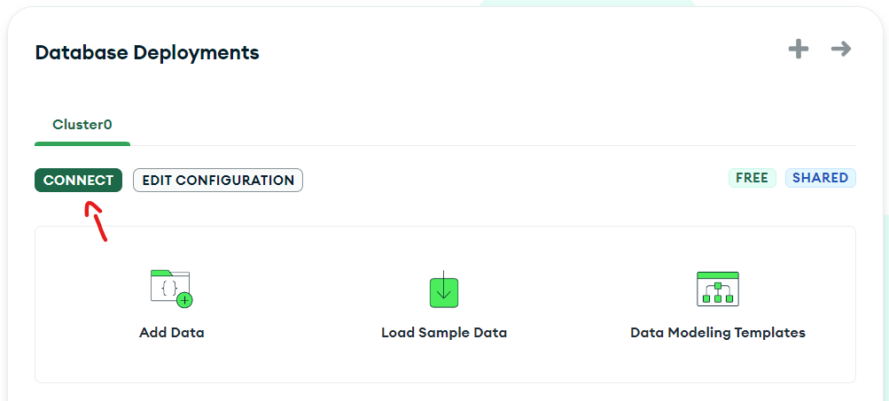

Now Click on Connect
Now Select Compass Option

Slide 12
And Copy the Connection String
And Paste It in the backend / .env file and replace the
<password> with the password.
In mongodb uri don’t add ” / ” in the end

Slide 13
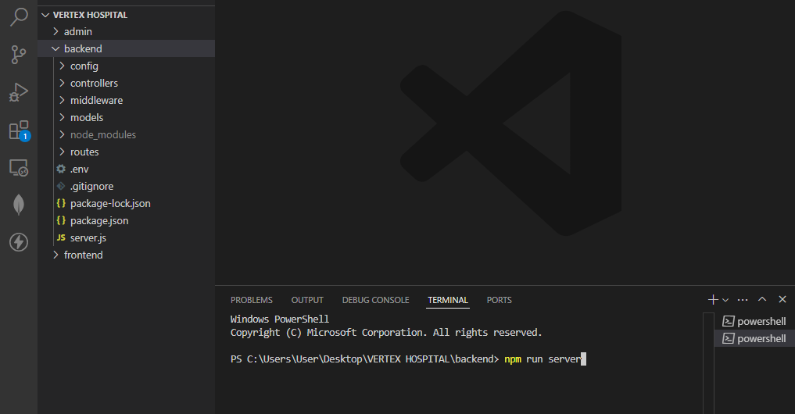
To Run Backend use npm run server command
in Integrated Terminal

Slide 14
“ Before Running Frontend or Admin Projects
make sure Backend is Running in the
background terminal”
Steps To Run Frontend of The Project
Right Click on ‘frontend’ folder > Select “Open In Integrated Terminal”
Type “npm install” and press Enter and Wait for Installation to be completed (requires Internet)

Slide 15
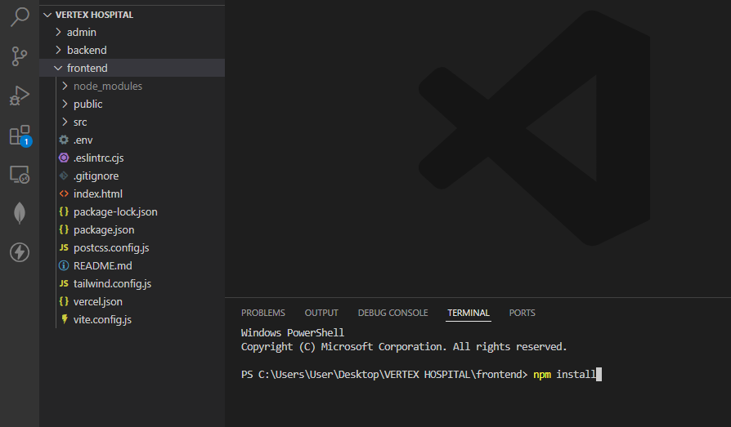

Slide 16
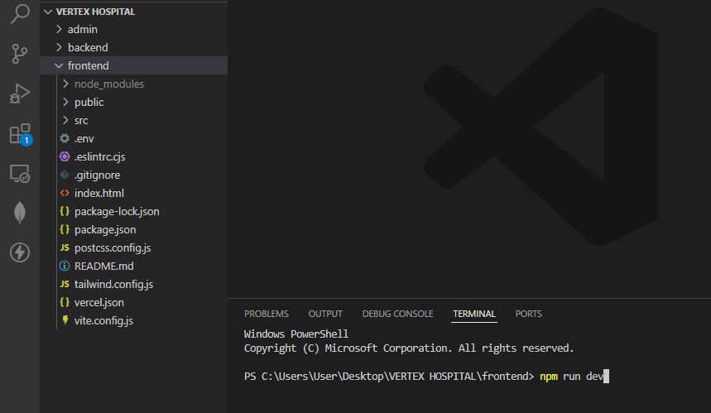
After that type “npm run dev” in terminal
Now you will see the ‘http://localhost:5173’ link in that terminal. Open that link in the browser

Slide 17
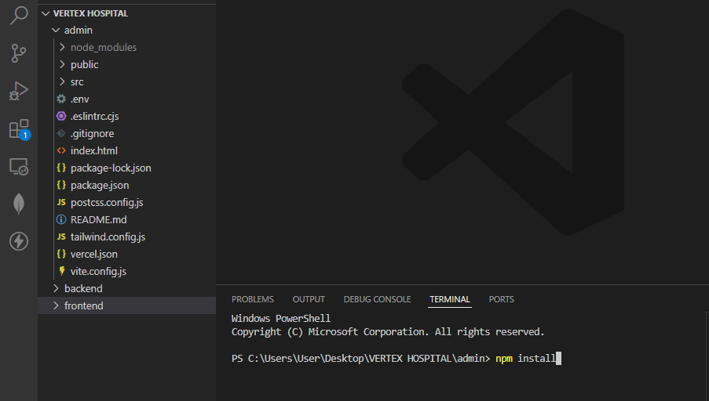
Steps To Run Admin Panel of The Project
Right Click on ‘admin’ folder > Select “Open In Integrated Terminal”
Type “npm install” and press Enter and Wait for Installation to be completed (requires Internet)

Slide 18
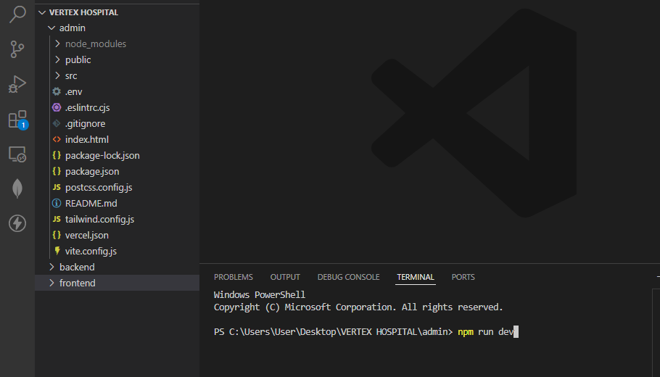
After that type “npm run dev” in terminal
Now you will see the ‘http://localhost:5174’ link in that terminal. Open that link in the browser.

Slide 19
THANKS
BHANU PRATAP SINGH
IITGCS 2406 1512

